Slide 1
Microservices & Azure Service Fabric
S. Kyle Korndoerfer
Kyle.Korndoerfer@gmail.com
@KyKoSoft

Slide 2
Traditional Architecture
The monolith

Slide 3
Monolithic Design
Load Balancer
Application
Application
User Interface
User Interface
Business Logic
Business Logic
Data Access Logic
Data Access Logic
Persistance Layer
Persistance Layer
Persistence Layer
Notes:
Traditional monolith design is pretty common in most application frameworks, even the web. Some frameworks make it easier to avoid full monolithic design by shipping with separate Web UI and Application servers (or at least make it easier to pull out the Web UI). Still, the default is generally that everything is hosted together (Java Enterprise Servers) so most people just stick with it.
{advance the slide}
The Application may consist of several layers that each have a specific responsibility, but the layers all live together.
{advance the slide 4 times through the application layers}
This means that in order to scale the application, all parts of the application are deployed and consume resources (disk space, CPU, memory).
{advance the slide to show another instance}
The only parts of the whole application stack that can be scaled separately are the Load Balancer and the Persistence Layer (typically some form of database server).

Slide 4
What are Microservices?

Slide 5
Do one thing, really well
Unix Philosophy
Notes:
The less code you have, the less you have to worry about…
The less you have to test means it’s easier to prove that it works correctly in all cases.

Slide 6
Small unit of work with a Single Responsibility
S in SOLID Principles

Slide 7
An individual unit that can be built, tested, deployed, and scaled independently of other services
Can be a separate process or a container

Slide 8
An example
Web UI
Web UI
Web UI
Web UI
Web UI
Order Service
Order Service
Order Service
Order Service
Inventory Service
Inventory Service
Inventory Service
Restock Service
Restock Service
Payment Service
Payment Service
Payment Service
Notes:
As an example, a fictitious online storefront could be structured with the following services.
{advance the slide 5 times}
Because of this structure, if the Order service is having trouble processing all of the requests from the Web front end we can add another instance of the Order service to share the load.
{advance the slide}
Next, maybe the Web service starts to have trouble handling the user load (but all of the other services are good because not all users place an order)
{advance the slide}
Then the Inventory service, and so on.
{keep advancing until the 3rd payment service is shown)

Slide 9
But now we have how many services?
We typically use a load balancer for the web UI… What about the other services?
What if a service goes down?
How is the state maintained and replicated?
How do we monitor each service for reliability and health?
How do new services get spun-up to replace the lost services?
How are these new services added to the pool and made available?

Slide 10

What is Azure Service Fabric?
Notes:
Video Source: http://aka.ms/servicefabricvideo

Slide 11
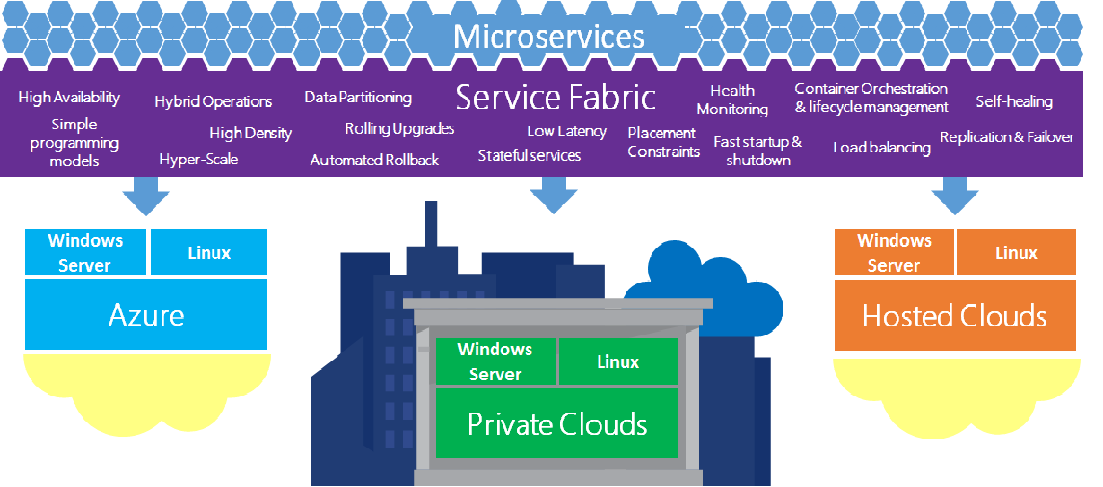
Service Fabric Overview

Slide 12
Architecture
Reliable, Scalable Applications
Application Model
Declarative Application Description
Native and Managed APIs
Management
Subsystem
Deployment, Upgrade, and Monitoring
Communication
Subsystem
Service discovery
Reliability
Subsystem
Reliability, Availability, Replication, Service Orchestration
Hosting & Activation
Application Lifecycle
Testability
Subsystem
Fault Inject,
Test in Production
Federation Subsystem
Federates a set of nodes to form a consistent scalable fabric
Transport Subsystem
Secure point-to-point communication
Notes:
You start by building your application, composed of multiple services. This is the logic and functionality that you want to provider to your end-users.
{advance the slide}
Using Service Fabric, you can leverage a lot of the hard work already done around managing and scaling your services.
{advance the slide}
There is an Application model that consist of the different types of services that you can create (Stateless, Stateful, and Actors) in both native and managed APIs
{advance the slide}
… a Management subsystem that automates the deployment, upgrade, and health monitoring of your application…
{advance the slide}
… a Communication subsystem that automatically handles the discovery and balancing of your services…
{advance the slide}
… a Reliability subsystem that is in charge of keeping your service available and replicated …
{advance the slide}
… a Hosting subsystem the manages the individual processes and activates services when requested (since not all service/actor instances need to be running at the same time) …
{advance the slide}
… a Federation subsystem for linking the nodes into a single, scalable fabric …
{advance the slide}
… a Transport subsystem that allows your services to be invoked over a number of different protocols (TCP, UDP, HTTP, WCF, etc.) without the core service code itself aware (ICuommunicationListener) …
{advance the slide}
… and finally, a Testability subsystem that gives DevOps the capability to simulate all sorts of randomized failure scenarios automatically in the running application (think Netflix Simian Army of tools; Chaos Monkey)

Slide 13
Application Structure
Application
Service
Service
Service
Code
Config
Data
Code
Config
Data
Code
Config
Notes:
The top level of your application is simply metadata that defines all of the services that make up your application.
{advance the slide}
Each service is further composed of 3 distinct parts…
{advance the slide}
… the code that performs the work …
{advance the slide}
… the configuration that determines how the service will run …
{advance the slide}
… and any optional static data that the service needs while running.

Slide 14
Application Package Layout
Application
ApplicationManifest.xml
Service1
ServiceManifest.xml
Code
Service1.exe & *.dll’s
Config
Settings.xml
Data (optional)
(any # of data files/formats)
Application
Service
Code
Config
Data
Notes:
When your application is packaged and ready for deployment, it will have the following structure:
{advance the slide}
An application manifest that defines all of the services that make up your application.
{advance the slide}
For each service, there is a service manifest that describes the various components of the service and the versions of each
{advance the slide}
Further, each service contains a Code folder where all of your services dependencies are stored …
{advance the slide}
… a Config folder that stores all of the various configuration settings for the service (could have multiple configuration; one for each environment) …
{advance the slide}
… and an optional Data folder that contains any static data that the service needs at runtime or to initialize the service.

Slide 15
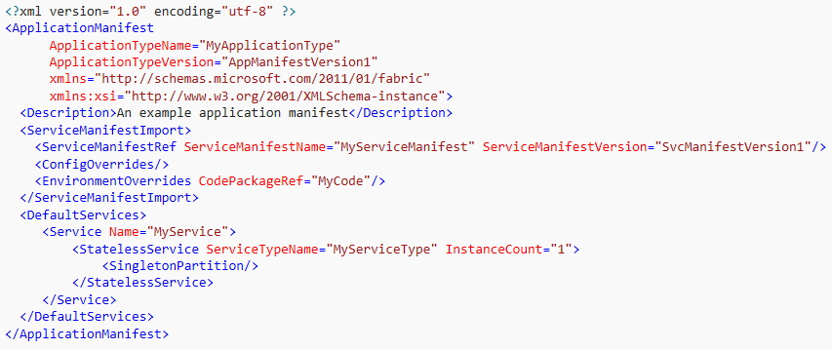
Application Manifest
Application

Slide 16
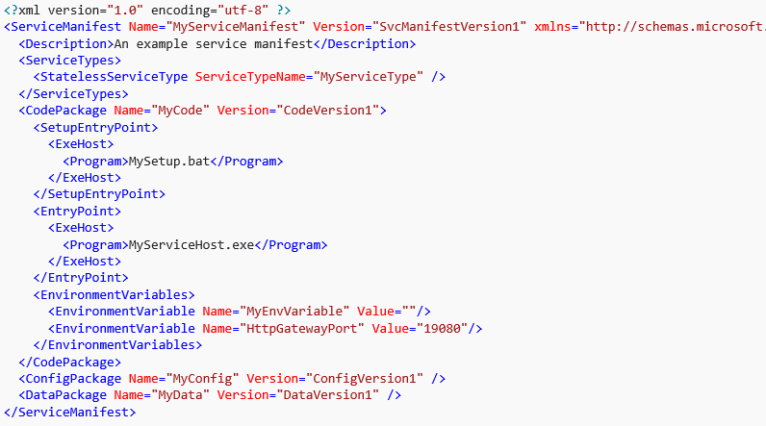
Service Manifest
Service
Notes:
Notice that each service can have a SetupEntryPoint, for performing any necessary initialization or setup before starting your actual service (think NodeJS ‘npm install’) and a main EntryPoint, your actual service code.
You can also define and pass environment variables to your application that, using the configuration files, can have specific values per environment.

Slide 17
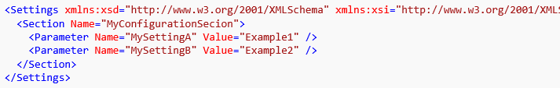
Service Config
Config

Slide 18
Getting Started with Service Fabric

Slide 19
Local Development Environment
Visual Studio 2015 w/ latest Service Pack or 2017
Any edition works, including the free Community Edition
Install the Azure Fabric SDK from Web Platform Installer
Installs a local emulator/runtime with either 1 or 5 nodes
1 node – faster deployments; simplest way to start building services
5 nodes – slower deployments; simulates coordination among service nodes
Installs Visual Studio tooling (New Project wizards; solution management)
Same runtime code as deployed in Azure

Slide 20
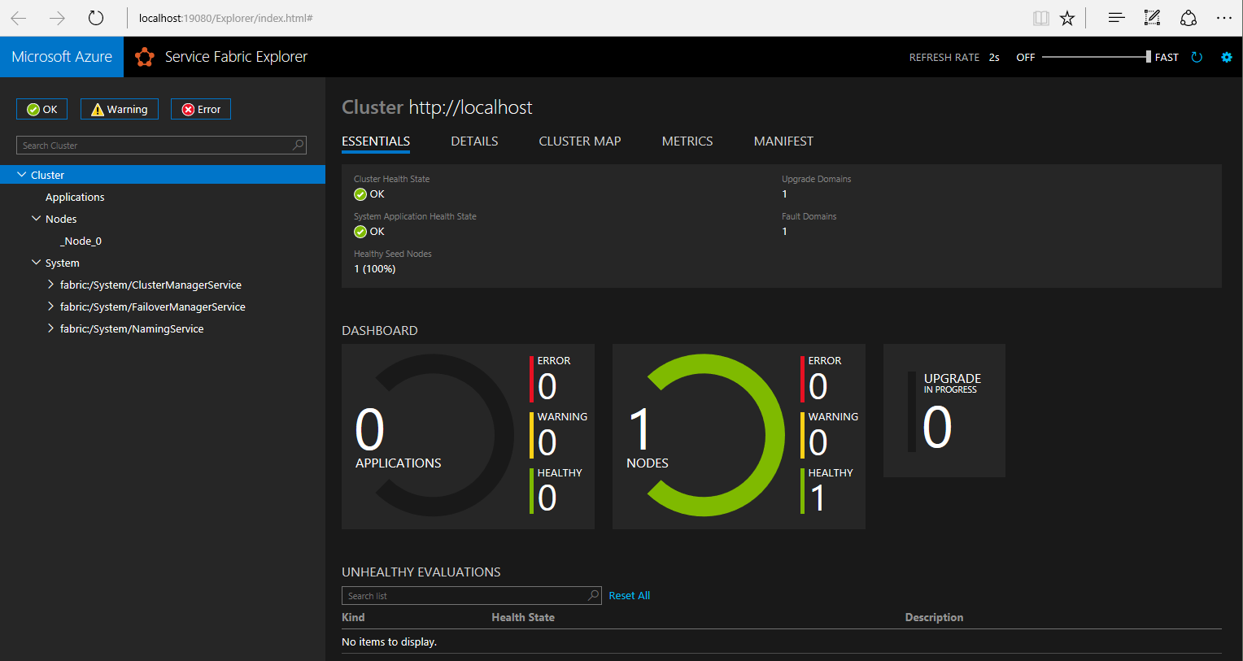
Management: Service Fabric Explorer
Notes:
Each deployment of Service Fabric comes with a web-based management console available on port 19080.
This allows DevOps to see the current state of the cluster with lots of detailed information at each level. It also allows you to take some management actions like taking a node offline, rolling back an application to a previous version, etc.
(Launch the local SFX and show that the system services themselves are microservices; keep this running and show what each type of deployment looks likes)

Slide 21
Types of Services

Slide 22
Service Types
Guest Executables
Anything that can be executed by the host
*.exe,*.bat
Reliable Services
Stateless
Stateful
Reliable Actors

Slide 23
Reliable Services
Simple programming model & lifecycle
Define one or more ICommunicationListener instances for communication from external sources
Stateless: CreateServiceInstanceListeners()
Stateful: CreateServiceReplicaListeners()
Background processing
RunAsync()
Must define at least one, but you could define both
Notes:
By defining more than one communication listener, you allow your service to be consumed in multiple ways without having to modify the core code of the service.
For instance, you could define an HTTP endpoint for REST calls from web front ends and a WCF endpoint for more traditional Web Service calls.
The RunAsync() method is typically used as a background processing loop that monitors some data structure and performs some unit of work when needed.

Slide 24
Stateless Service
No state maintained within the service across calls
All data is provided when called (or can be retrieved from some other source)
Very fast because there are no primary/secondary nodes requiring replication
Any call can be serviced by any instance of the service
If any state needs to be maintained for some reason, it must be maintained externally (Database, Redis cache, etc.)
Simple examples:
Calculations like Sales tax, Shipping cost, etc.
Logging Service
Web Nodes (ASP.NET MVC/API, NodeJS, Angular, etc.)

Slide 25
Demo #1
Creating a Stateless Service
Notes:
Create a Stateless service in Visual Studio
Explain the need to open Visual Studio as an Admin in order to debug
Use the basic example that just shows a counter incrementing in the logging
Introduce the Service Fabric Explorer
Kill the node the service runs on and show that the counter resets to 0

Slide 26
Stateful Service
State is stored locally (in memory and/or on disk) and replicated across nodes/instances using reliable collections
IReliableDictionary & IReliableQueue
Transactions are required to store and retrieve data from these data stores to prevent corruption since multiple services can be working on the data at the same time.
Due to replicas, there is a built-in mechanism for utilizing a Command/Query separation pattern
Read-only calls can be ‘forced’ onto the secondary nodes since no state mutation occurs
Frees up the primary node to service data mutation requests
Notes:
Currently, only 2 reliable collections are provided, but there is a API for writing your own.
Stateful services are often defined with both an external communication channel (or more than one) along with a RunAsync() loop.
The communication channels only receive the data and place it into a reliable collection or return the results of a previous request (when ready). This allows your service to handle a larger number of incoming request with fewer deployed service instances.
The RunAsync() loop will then monitor the reliable collection and perform the real work in the background as needed.

Slide 27
Demo #2
Creating a Stateful Service
Notes:
Create a Stateful service in Visual Studio
Use the basic example that just shows a counter incrementing in the logging and being stored in a Reliable Dictionary
Kill the node the service runs on and show that the counter continues

Slide 28
Actor Services
A special type of service based on the Virtual Actor pattern
An actor is an isolated, independent unit of compute and state with single-threaded execution
Each instance of an Actor can execute simultaneously and independently of each other
This means that each Actor has an identity and a lifetime
Built on top of Reliable Services, each Actor service you write is actually a partitioned, stateful Reliable Service
Notes:
When thinking about Actors, it’s easiest to just think of them as instances of a class… where you only have limited control of the object lifetime.
You don’t create an instance of an Actor; you ask the fabric runtime, using a proxy, to locate an instance of an Actor by it’s unique identifier. If an instance doesn’t already exist in the fabric, then the runtime will first create an instance and then return it to you. This reference is actually an Actor Proxy that allows you to communicate with the instance in the cloud.

Slide 29
Demo #3
Creating an Actor Service
Notes:
Create an Actor service in Visual Studio
Use the basic example that just shows a counter incrementing in the logging
Create a test client (Console App, switch to 64-bit, add Actor NuGet references, add project reference to Interface project)
Talk about why we new up a new actor instance every time we loop
Kill the node the primary service runs on and show how quickly it recovers (secondary becomes primary & new secondary is created)?

Slide 30
Putting It All Together
Basic application that uses all service types.

Slide 31
Sample App
Web Site (Stateless)
User Service (Actor)
Register User (create)
Sends a welcome email
Login w/ password validation
Email Service (Stateful)
Listener receives messages & places them directly in a Reliable Queue
RunAsync() processes the messages from the Reliable Queue
Logs result to the Event Log

Slide 32
Demo #4
Simple application using multiple microservices
Notes:
Create a new Service Fabric application in Visual Studio
Start with ASP.NET Core application (Core v1.1 + Web App template)
Show that it is just a Stateless Service that starts OWIN/Katana
Add the User Actor service
Update interface to have ChangePassword(old, new) & UpdateLastLogin()
Add the Stateful Email service
Communication Interface (use RPC to keep it easy)

Slide 33
Resources
https://www.martinfowler.com/articles/microservices.html
Azure: https://azure.microsoft.com/en-us/services/service-fabric/
Docs: https://docs.microsoft.com/en-us/azure/service-fabric/
Programming Microsoft Azure Service Fabric book by Haishi Bai
Advanced MVA course: https://mva.microsoft.com/en-US/training-courses/service-fabric-patterns-and-practices-16925

